Slide 1
Starting up a company in Maryland
Jihoon park, PhD
Chief operating officer
Teraimmune, inc.

Slide 2
TeraImmune, Inc.
Series A funding
(Dec 2019-Sep 2020)
First-in-human Clinical Trial (2H 2021)
Laboratory setup
(Jan 2020)
Angel investment
(Jul 2019)
Research
(2007-2018)
Incorporation
(Sep 2016)
SBIR Phase 1
(Apr 2018)
PACT program awarded
FDA meeting (INTERACT)
SBIR Programs
IPO
(2023)
8 FTEs

Slide 3
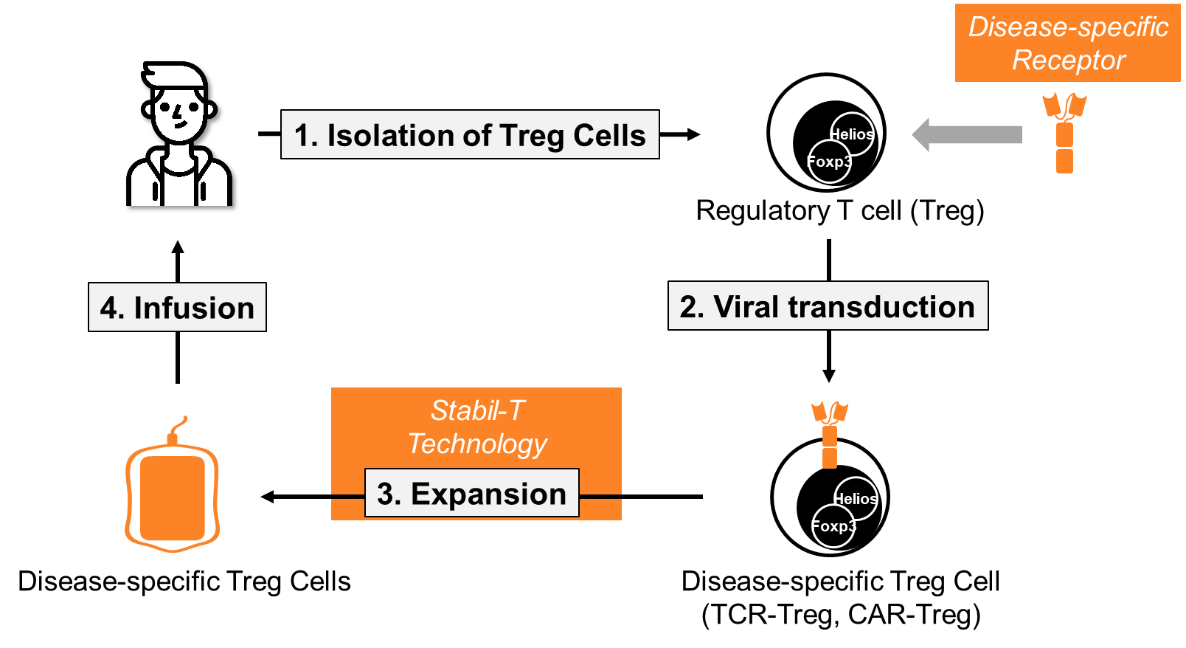
Immune cell therapy: TCR-Treg
Target specific receptors: T cell receptor (TCR), Chimeric antigen receptor (CAR)
Active ingredient: Regulatory T cells (Treg)
Indications:
anti-drug antibody formation in Hemophilia A
Multiple Sclerosis
Xenotransplantation
Atopic Dermatitis
First-in-human clinical trial in 2H 2021

Slide 4
Why and why not
Why? |  | Why not?
Federal institutes (NIH, FDA, NIST, NSF) | Location | 13-14 hours difference between MD and Korea (tired of working at day and night)
Time difference between MD and Korea (can work at day and night) |  | Federal institutes (Government)
CRADA w/Federal labs | Opportunity | Few private capital sources
Lots of unique IP |  | No exclusivity
Gentle weather and no disasters Very similar to Korea | Geography | No Yellowstone, No Disney
Great public schools! |  | Great public schools!!
Variety of scientific human resources | Resources | Few human resources in business
Easy to stay (J1 VISA) |  | Hard to move (VISA or Green card)
This is Jihoon Park’s opinion. It does not represent Teraimmune.

Slide 5
Welcome to Maryland
Contact information: jpark@teraimmune.com
Website: www.teraimmune.com
WE ARE ACTIVELY HIRING in MULTIPLE POSITIONS!

