Slide 1
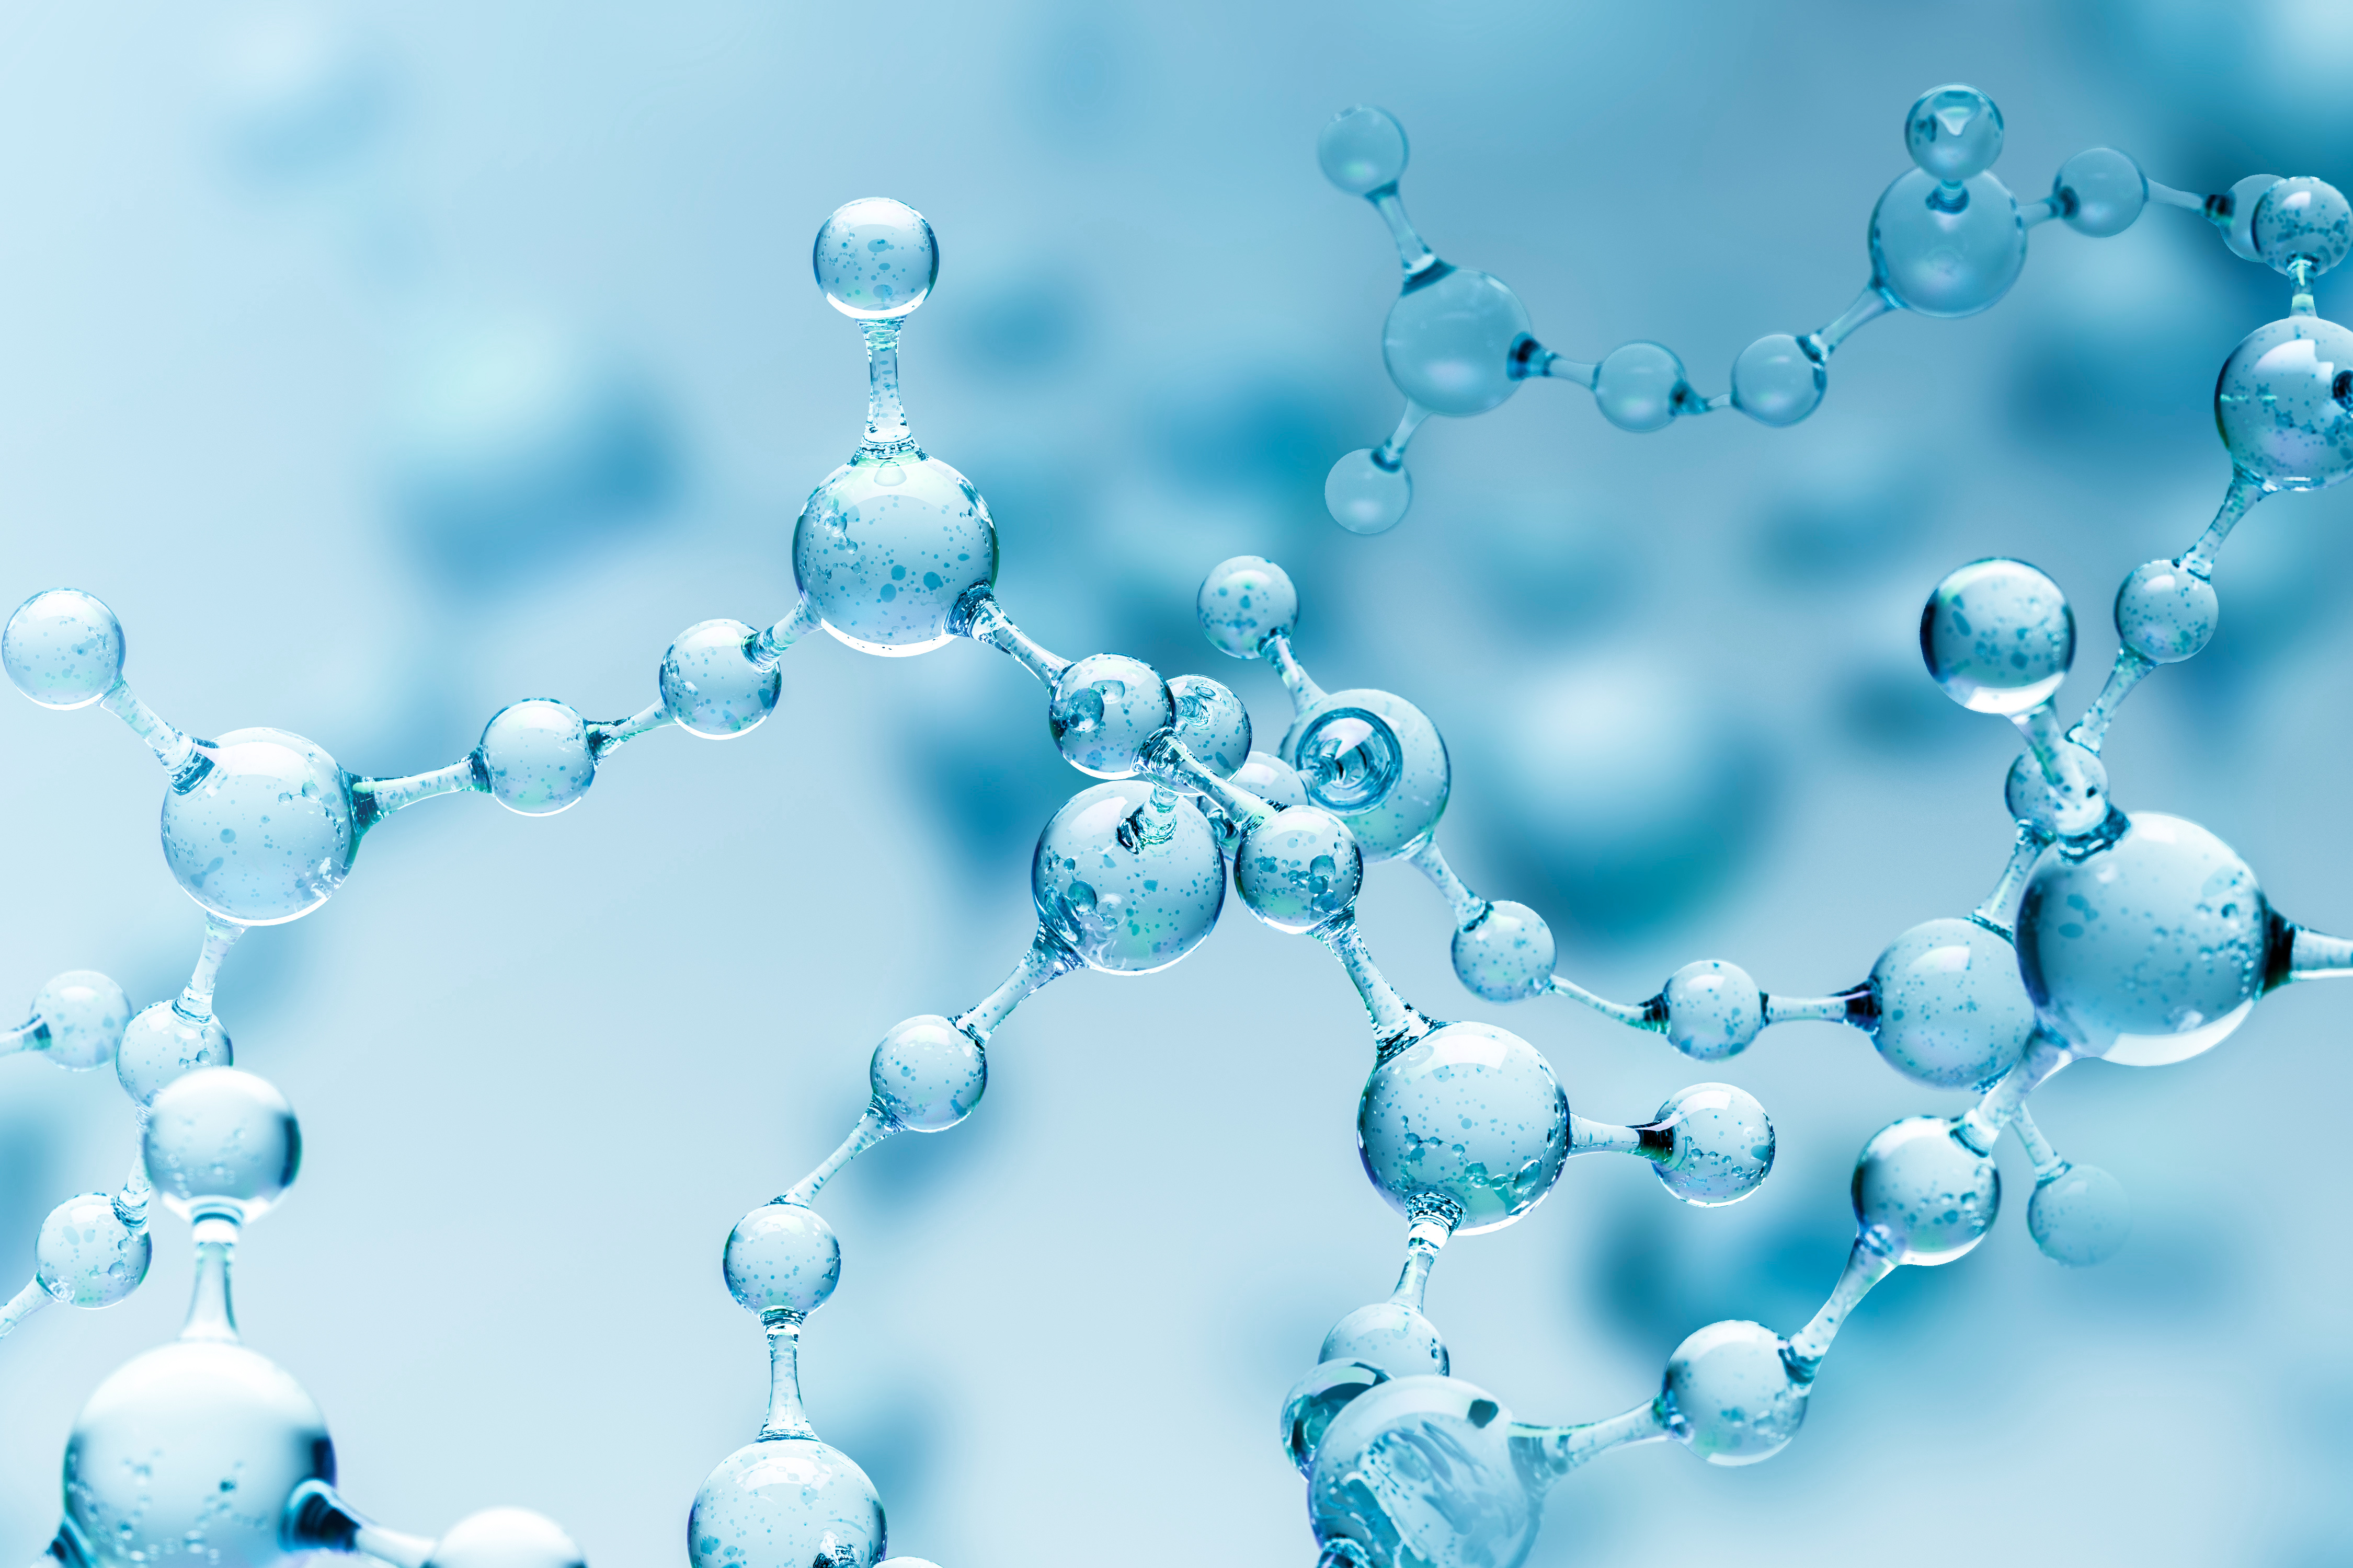
KCRN RESEARCH
Giving Flexibility to Early Phase Drug Development
Joseph Hong
Business Development Manager

Slide 2
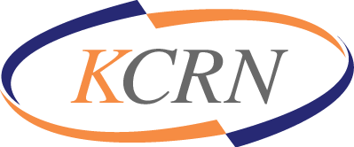
KCRN RESEARCH
KCRN Research is a clinical CRO (Contract Research Organization) that is committed to providing clinical and regulatory services to small and mid-size pharmaceutical/biotech companies looking for a strategic and effective approach to early phase drug development.
As of today, KCRN…
Has 28 full-time employees
Works with about 20 pharmaceutical/biotech companies
Currently Managing 7 clinical trials
Currently Preparing 5 IND packages

Slide 3
KCRN HISTORY
2012 Founded as a clinical & regulatory agent service company
Germantown Innovation Center (20271 Goldenrod Lane 2F, Germantown, MD)
2014 Started full CRO services
Received ‘ExportMD Award’ from Maryland Department of Commerce
Won ‘Start Up Business of the Year’ from Montgomery Country
2015 Moved to 20251 Century Blvd. Suite 325, Germantown, MD
2017 Established internal clinical trial management systems (e.g., eCTD, EDC, eTMF)
Opened 2nd suite (20251 Century Blvd. Suite 335, Germantown, MD)
2018 Opened Korea branch as a strategic partner company
2019 Established internal quality assurance division
2020 12311 Middlebrook Rd. Suite 200, Germantown, MD

Slide 4
KCRN APPROACH
Sponsor-centered operations for early phase clinical trials
Concentrated, efficient management for early phase clinical trials
Fixed costs and flexible operations/system
For Korea pharmaceutical/biotech companies
Frequent communication in English/Korean
Working in same working culture
Less burden for contracts/budgets

Slide 5
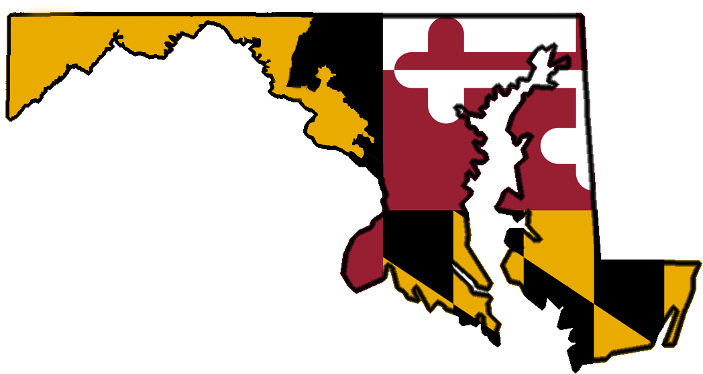
THE MARYLAND CONNECTION
KCRN is in Germantown, Maryland situated next to FDA Headquarters in White Oak, MD and the US National Institutes of Health (NIH) in Bethesda, MD, Johns Hopkins University in Baltimore, MD and the University of Maryland in College Park, MD
Part of one of the largest Life Science hubs in the nation with the potential to grow even higher with a rapidly growing Maryland-South Korea BioHealth partnership
The State of Maryland is a top leader in US BioHealth innovation, investment & funding
Maryland is the 4th highest ranked Life Science Cluster in JLL’s 2020 U.S. Life Sciences Outlook
The Maryland State government is a key driver of growth in the drug development industry with policies and initiatives friendly to the BioHealth community
Maryland is 1st In NIH Research & Development Contract Awards*
*data from Maryland.gov

Slide 6
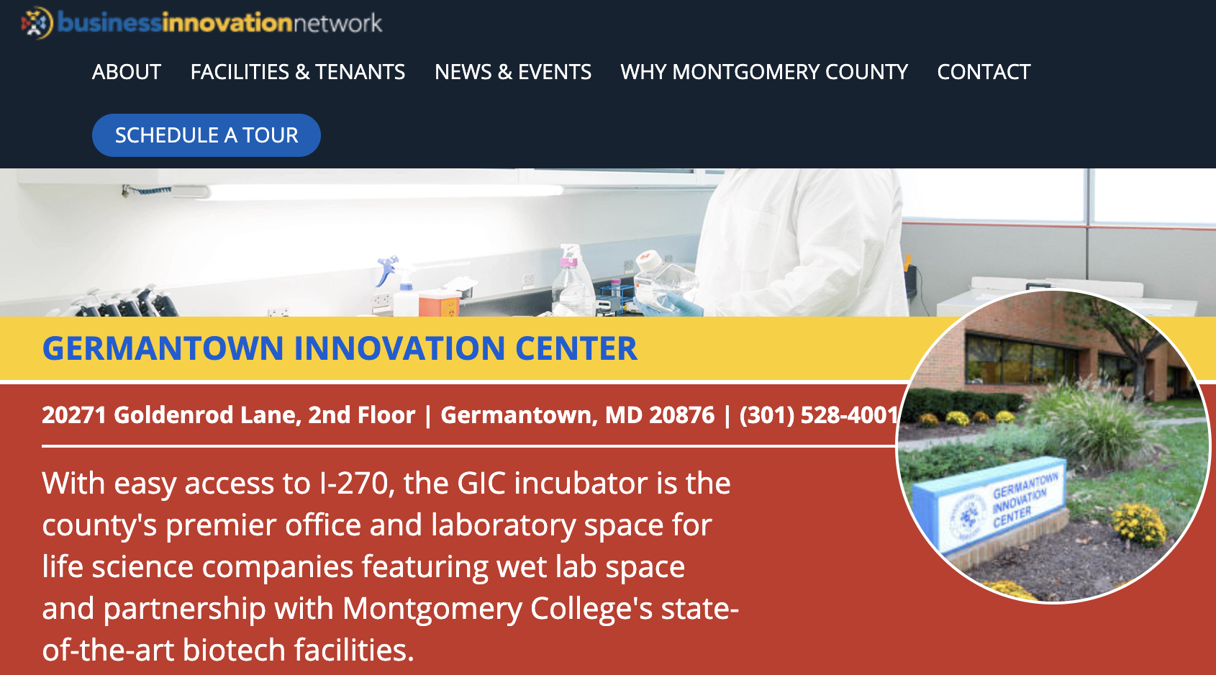
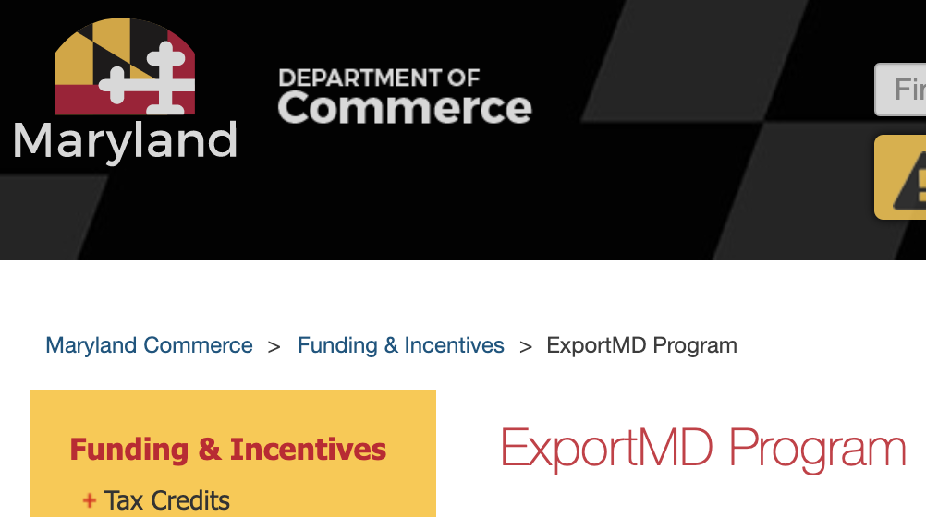
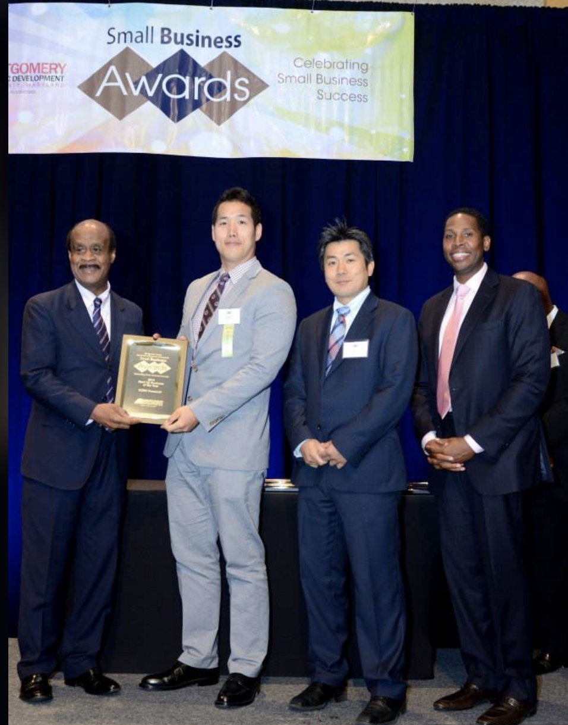
KCRN IN MARYLAND
KCRN started in Germantown Innovation Center and stayed for 3 years.
https://www.mcinnovationnetwork.com/facilities-tenants/germantown-innovation-center/
KCRN received about $5,000 for ‘ExportMD’ program of Maryland
https://commerce.maryland.gov/fund/programs-for-businesses/exportmd-program
KCRN won ‘2014 Start Up Business of the Year’ from Montgomery Country

